Slide 1
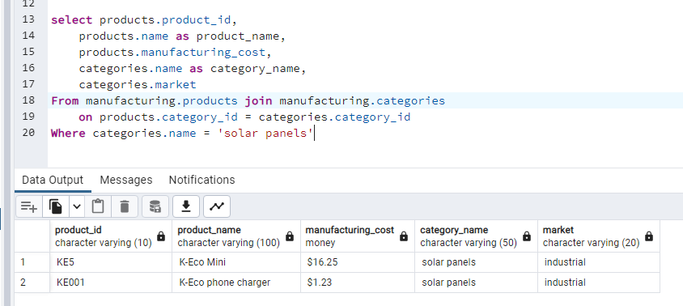
Comma-separated list of columns wanted in the results. They are in the form table.column
The “as” changes the name of the column in the results table
The “join” is used to specify two tables used to produce the results.
The name of the table where the data is stored. They are in the form schema.table
The “on” specifies which column in the two table are linked. This is like the Excel vlookup value

Slide 2
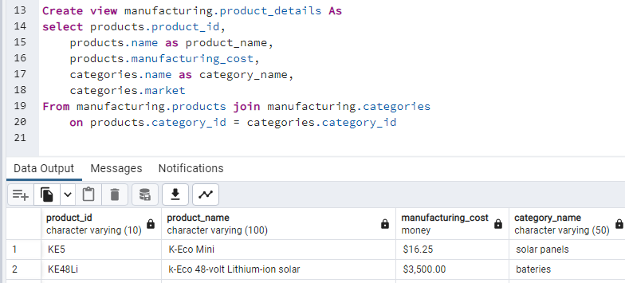
Comma-separated list of columns wanted in the results. They are in the form table.column
The “as” changes the name of the column in the results table
The view is saved in with a name in the form of schema.name
The “join” is used to specify two tables used to produce the results.
Create view essentially saves this query so you can be easily used again
The name of the table where the data is stored. They are in the form schema.table
The “on” specifies which column in the two table are linked. This is like the Excel vlookup value

Slide 3
SELECT table_1.column, table_2.column
FROM schema.table_1
JOIN schema.table_2
ON table_1.column_key = table_2.column_key

Slide 4
